Slide 1
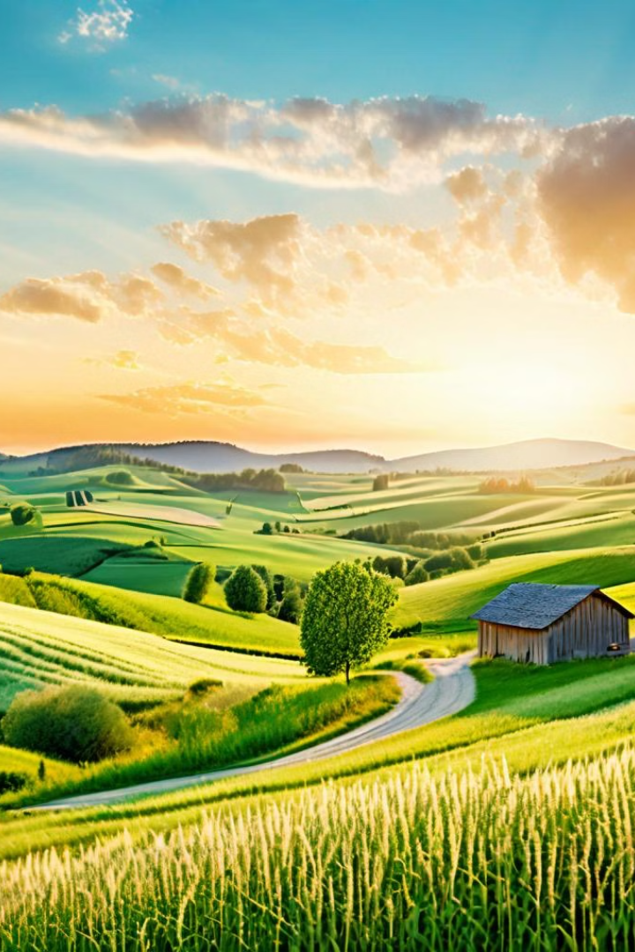
AgroVoyage
This innovative agrotourism website aims to bridge the gap between urban dwellers and the agricultural world, offering a unique opportunity to experience the beauty and tranquility of farm life.
K.Swagath Reddy
Jai Gopal Abhiram
P V L S Datta Manas
B.Sai Anirudh Goud

Slide 2

Problem Statement
Incorporating Augmented Reality (AR) technology, our project aims to address the challenge of engaging urban populations with farming practices. By providing an immersive AR experience, we seek to bridge the gap between agricultural knowledge and urban lifestyles, fostering appreciation for farming heritage and empowering users to identify crop diseases and pest infestations early. Through interactive simulations and educational content, our platform aims to promote sustainable farming practices and encourage participation in weekend farming activities, ultimately contributing to the revitalization of agrarian communities.

Slide 3
Abstract
Bridging the Gap
Empowering Farmers
Sustainable Tourism
The agrotourism website aims to bring urban dwellers and rural farmers together, fostering a deeper understanding and appreciation for the agricultural industry.
By providing a platform for farmers to showcase their farms and offer unique experiences, the website helps them diversify their income and promote their businesses.
The website promotes eco-friendly, responsible tourism that supports local communities and preserves the natural environment.

Slide 4

Existing System vs New System
1
Limited Reach
The existing system relied on traditional marketing and word-of-mouth, limiting the exposure of farms to potential agrotourists.
2
Innovative Features
The new system incorporates cutting-edge technologies, such as AR and AI, to enhance the user experience and provide personalized recommendations.
3
Streamlined Booking
The website offers a seamless booking process, allowing users to easily plan and book their agrotourism experiences.

Slide 5
Methodology
User-Centric Design
Iterative Development
The website was developed using a user-centered approach, focusing on the needs and preferences of both farmers and agrotourists.
The team followed an agile methodology, continuously gathering feedback and implementing improvements to ensure the website meets the evolving needs of its users.
Sustainable Partnerships
Data-Driven Insights
The website fosters partnerships with local communities, environmental organizations, and tourism boards to promote responsible and sustainable agrotourism.
The website leverages data analytics and machine learning to provide personalized recommendations and predict crop yields, benefiting both farmers and visitors.

Slide 6



Technology Used
Augmented Reality
Data Analytics
Django
PostGreSQL
Django is a high-level Python web framework that enables rapid development of secure and maintainable web applications. It follows the "don't repeat yourself" (DRY) principle and emphasizes reusability and pluggability.
PostgreSQL is a powerful open-source relational database management system (RDBMS) known for its reliability, scalability, and extensibility. It offers features such as ACID compliance, support for complex data types
Innovative AR features allow users to virtually explore farms and experience the agricultural environment before their visit.
The website utilizes advanced data analytics and machine learning to provide personalized recommendations and predict crop yields, benefiting both farmers and visitors.

Slide 7
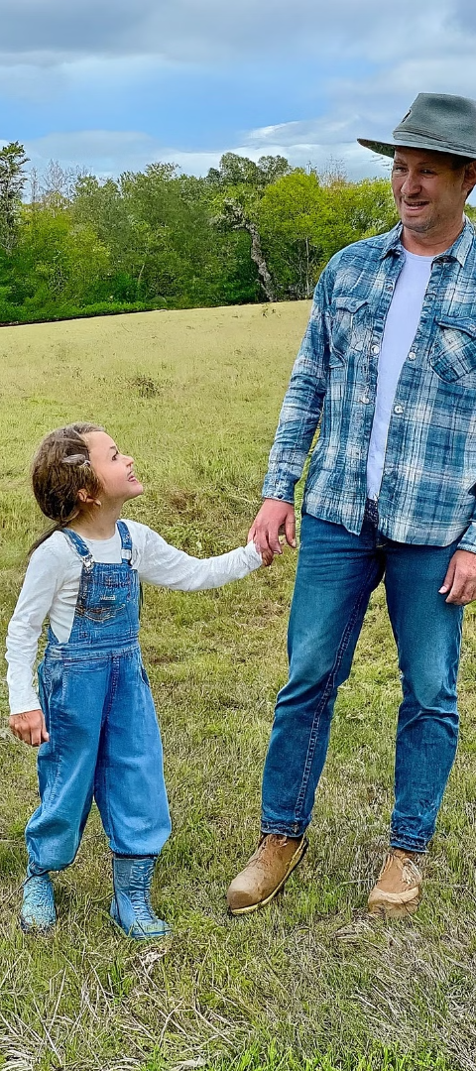



Conclusion
Bridging the Gap
The agrotourism website successfully bridges the gap between urban dwellers and the agricultural world, fostering a deeper appreciation for farm life.
Empowering Farmers
The platform empowers farmers by providing a new revenue stream and a way to showcase their farms and promote their businesses.
Sustainable Tourism
The website promotes eco-friendly, responsible tourism that supports local communities and preserves the natural environment.

